Slide 1
Employee Data Analysis using Excel
STUDENT NAME: PRABHA B
REGISTER NO: 6A0990D98E7404A91F54C99D7FF46070
COLLEGE REGISTER NO: 312208734
DEPARTMENT: B.COM [GENERAL]
COLLEGE : MEENAKSHI COLLEGE FOR WOMEN

Slide 2
PROJECT TITLE
EMPLOYEE PERFORMANCE EVALUATION USING EXCEL

Slide 3


AGENDA
Problem Statement
Project Overview
End Users
Our Solution and Proposition
Dataset Description
Modelling Approach
Results and Discussion
Conclusion
3/21/2024 Annual Review

Slide 4

PROBLEM STATEMENT
Evaluate Employee Performance: To assess how employees are performing across different departments and divisions.
Identify Strengths and Weaknesses: To pinpoint which areas are excelling and which need improvement.
Guide Decision-Making: To provide clear insights that help in making informed decisions about resource allocation, training, and support initiatives.

Slide 5

PROJECT OVERVIEW
The project aims to generate detailed insights into employee performance across various departments and divisions, offering a clear understanding of where resources are being utilized effectively and where there may be gaps.
By analyzing performance data, management can make informed decisions about where to allocate resources, such as funding, personnel, and time, to maximize efficiency and effectiveness.
Additionally, these insights will help identify specific training needs and areas requiring additional support, ensuring that interventions are targeted and impactful. Ultimately, this leads to better strategic planning and a more agile response to organizational challenges.

Slide 6

WHO ARE THE END USERS?
1. Management and Executives: They use the insights to make strategic
decisions regarding resource allocation, performance management, and
organizational development.
2. Human Resources (HR) Teams: They analyze the data to identify training
needs, improve employee engagement, and manage talent effectively.
3. Department Heads and Division Leaders: They use the information to
understand their team's performance, address weaknesses, and recognize
high-performing employees.
4. Performance Review Committees: They utilize the data for fair and
informed evaluations during performance reviews and employee appraisals.
5. Business Analysts: They interpret the data to provide actionable
recommendations for enhancing overall organizational performance.

Slide 7

OUR SOLUTION AND ITS VALUE PROPOSITION
Data Organization: The dataset was sorted based on gender
to structure the information accordingly.
2. Filtering: Specific divisions of interest were selected, and
irrelevant fields were removed to streamline the dataset.
3. Pivot Table Creation: A pivot table was constructed to
analyze employee performance, with the following structure:
- Rows: Departments
- Columns: Divisions
- Values: Average employee rating
4. Analysis: The pivot table provides a detailed view of average
ratings across different departments and divisions, facilitating
an in-depth comparison and offering insights into overall
performance metrics.

Slide 8
Dataset Description
ATTRIBUTES AND ITS TYPES OF THE GIVEN DATA SETS
Total number of columns – 26
EmpID: (Numeric), FirstName: (Categorical), LastName: (Categorical), StartDate: (Date), ExitDate: (Date, nullable), Title: (Categorical), Supervisor: (Categorical), ADEmail: (Categorical), BusinessUnit: (Categorical), EmployeeStatus: (Categorical), EmployeeType: (Categorical), PayZone: (Categorical), EmployeeClassificationType: (Categorical), TerminationType: (Categorical), TerminationDescription: (Categorical), DepartmentType: (Categorical), Division: (Categorical), DOB: (Date), State: (Categorical), JobFunctionDescription: (Categorical), GenderCode: (Categorical), LocationCode: (Categorical), RaceDesc: (Categorical), MaritalDesc: (Categorical), Performance Score: (Categorical), Current Employee Rating: (Numeric).
SELECTED COLUMNS FOR ANALYSIS
Total number of columns – 13
EmpID, FirstName, LastName, Title, EmployeeStatus, EmployeeType, EmployeeClassificationType, DepartmentType, Division, JobFunctionDescription, GenderCode, Performance Score, Current Employee Rating

Slide 9

THE "WOW" IN OUR SOLUTION
The analysis leverages a pivot table to compare average employee ratings across different departments and divisions, offering a clear view of performance metrics. By sorting the data by gender and removing unnecessary fields, the focus is sharpened on relevant information, revealing important trends and insights.
Additionally, the use of a bar chart to visualize the data enhances understanding and facilitates comparison, making it easier to communicate findings. This approach not only organizes and simplifies the data but also provides actionable insights that can guide strategic decisions and improve overall performance.
3/21/2024 Annual Review
9

Slide 10
MODELLING
STEP 1 : FIRST I LOGIN TO NAAN MUDHALVAN
STEP 2 : I ENTER MY NMID AND PASSWORD
STEP 3 : NEXT I CLICK MANDATORY COURSES
STEP 4 : I SELECT DATA ANALYSIS USING EXCEL
STEP 5 : THEN I CLICK WATCH, I CLICK ACCESS COURSE
STEP 6 : NEXT I CLICK EMPLOYEE DATA, AND DOWNLOADED THE DATA SET.
10

Slide 11
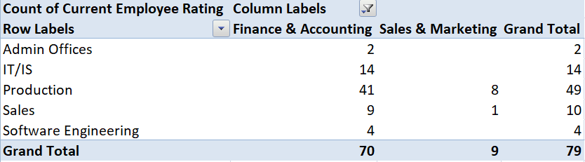
RESULTS
TABLE
11

Slide 12
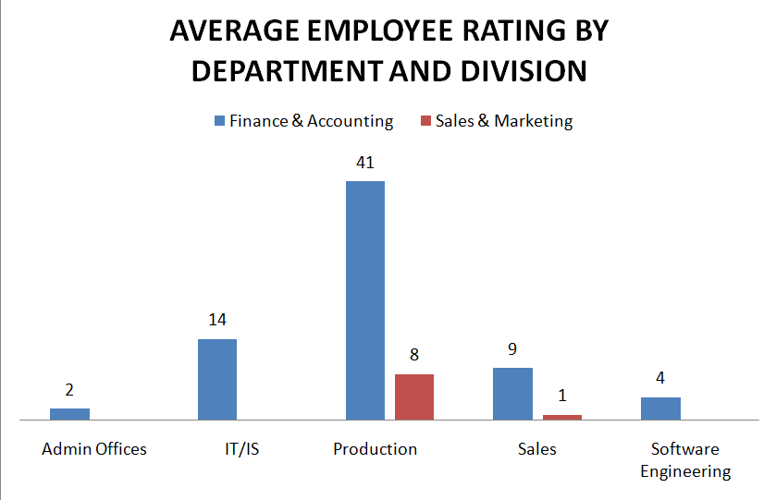
RESULTS
12

Slide 13
conclusion
The analysis provides a structured and insightful view of employee performance by using a pivot table to compare ratings across departments and divisions. The focused data management through sorting and field removal, coupled with clear visual representation via a bar chart, enhances the ability to interpret and communicate findings. This approach effectively highlights performance trends and areas for improvement, offering actionable insights that support informed decision-making and strategic planning.

